Slide 1

3D Modeling
Tutor : Liyan Chen
Email: chenliyan@xmu.edu.cn

Slide 2
Chapter 3
3D Animation Production Process

Slide 3

Section 1. The Production Process of 3D Animation
Preliminary Planning
Medium Production
Post Compositing

Slide 4
Preliminary Planting:
1、Project confirming
2、Collect data and write a script.
Film Type
Film Form
Footage

Slide 5
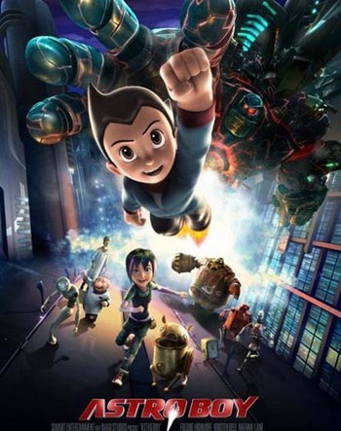

Slide 6
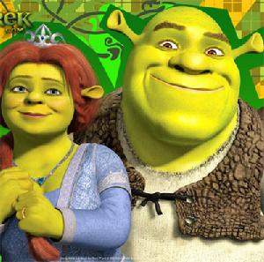
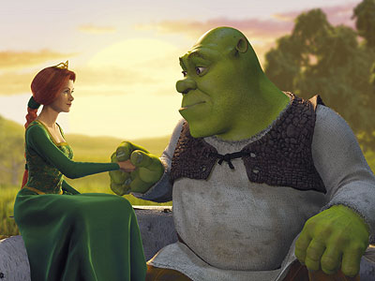

Slide 7
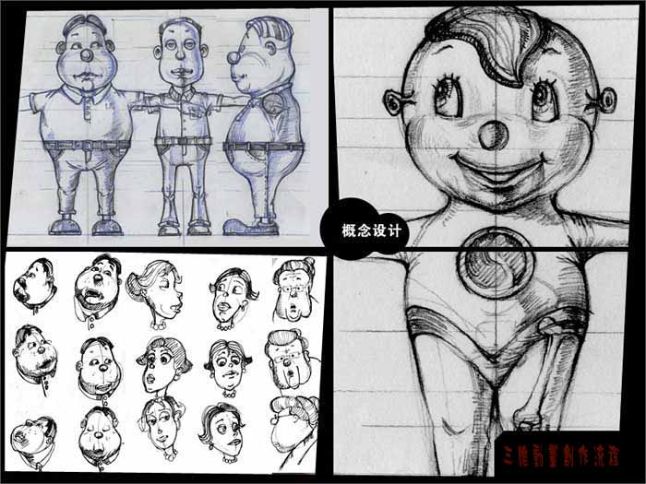
3、 Conceptual Design

Slide 8

《LION KING》Role Analysis

Slide 9
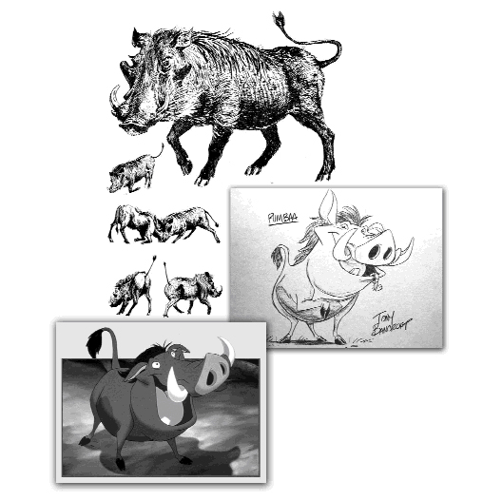
《LION KING》Role Analysis

Slide 10
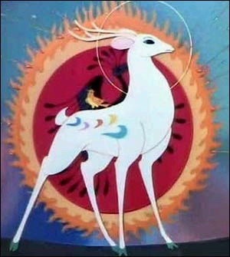
《NINE COLORED DEER》Role Analysis

Slide 11
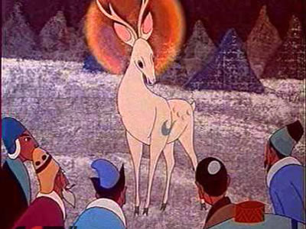
《NINE COLORED DEER》Role Analysis

Slide 12
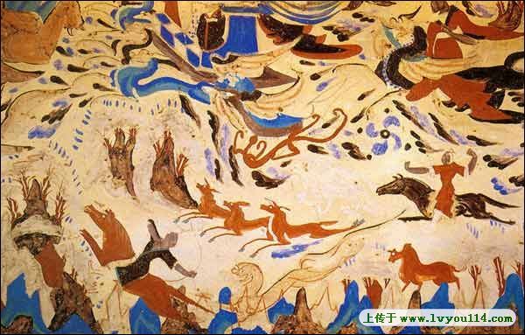
《NINE COLORED DEER》Role Analysis

Slide 13
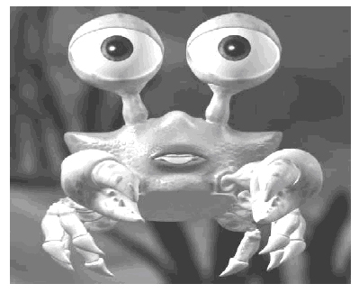
《BEACH STORY》Role Analysis

Slide 14
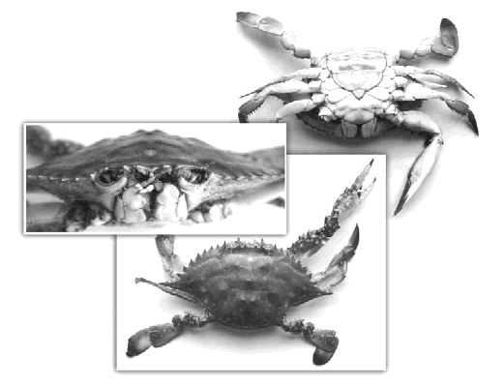
《BEACH STORY》Role Analysis

Slide 15
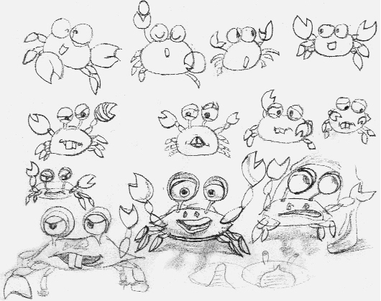
《BEACH STORY》Role Analysis

Slide 16
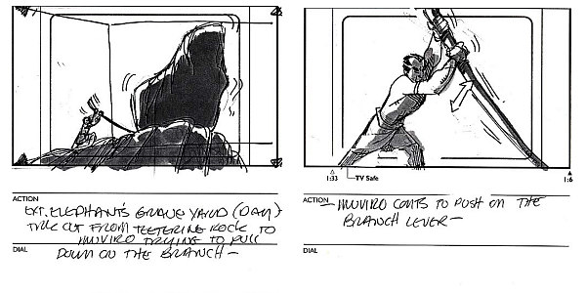

Slide 17
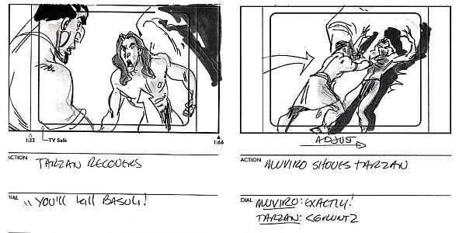

Slide 18
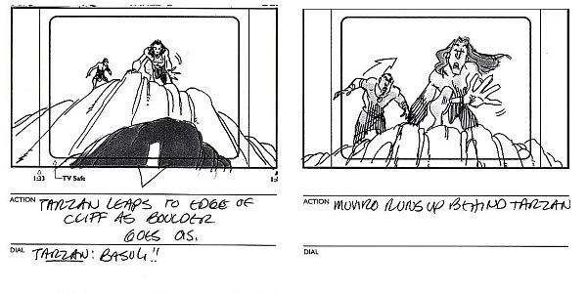

Slide 19
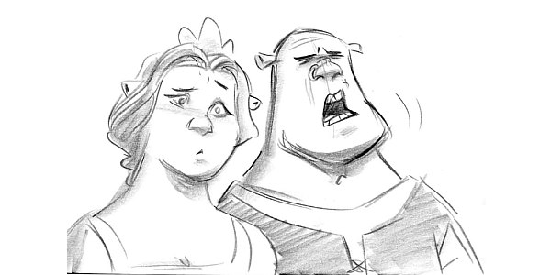
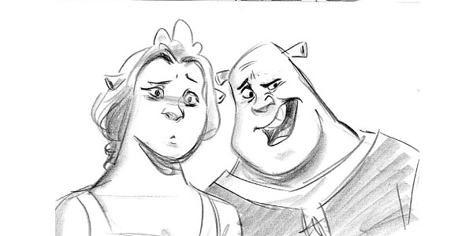

Slide 20
4.The arrangement of the work flow and the distribution of tasks:Usually a design project needs a team to complete and the division of labor cooperation can improve work efficiency.
5.The determination of technical solution and the technical problem solving.
3D Animation Software：3D MAX 、MAYA
Post Production：AE、Combution、Premiere

Slide 21
Medium Production:
In some ways，the 3D animation creation is a bit similar to sculpture, you can control various combinations in the 3D world.
In addition to basic skills, the most important thing is to have a deep knowledge of the art and more creativity.

Slide 22
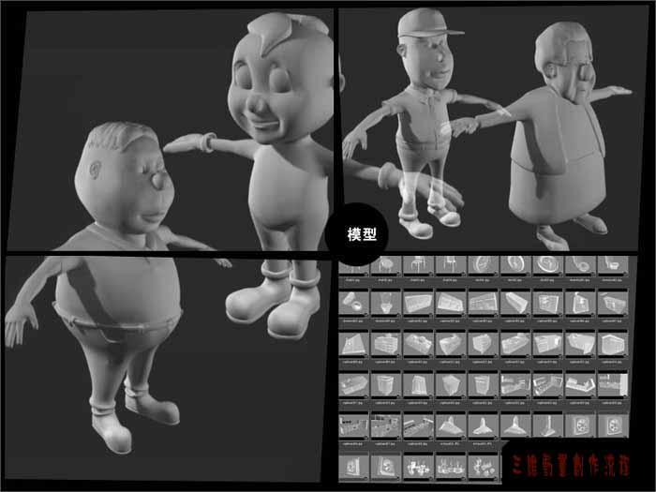
1. Modeling

Slide 23
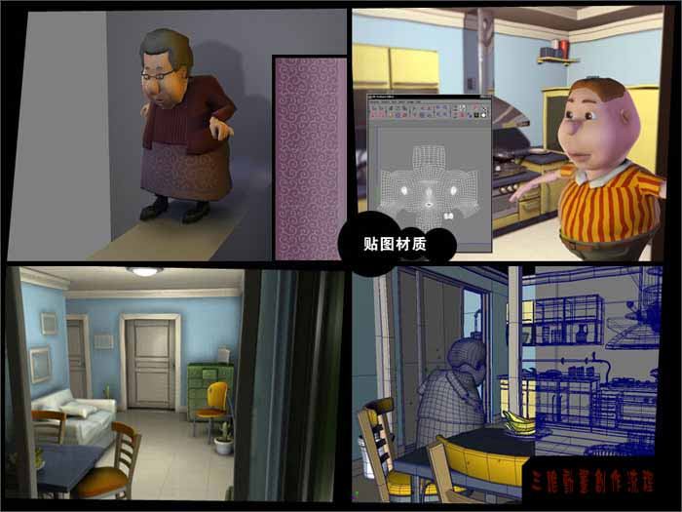
2. Shading & Texture

Slide 24
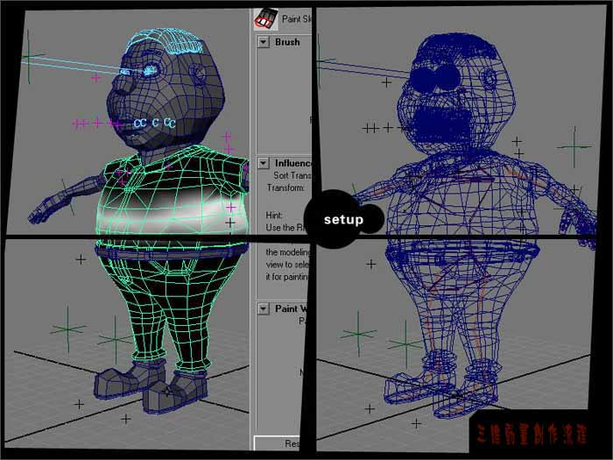
3、Skeleton and Skin (character rigging)

Slide 25
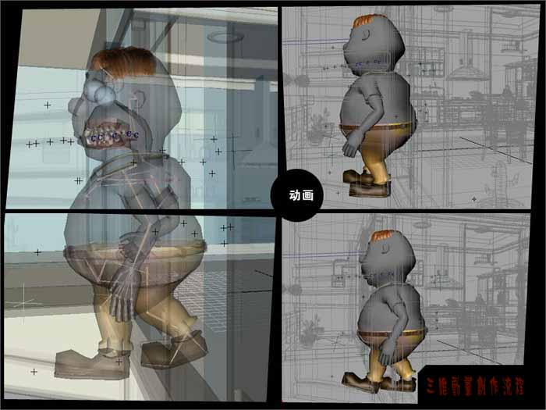
4、Shooting Animation

Slide 26
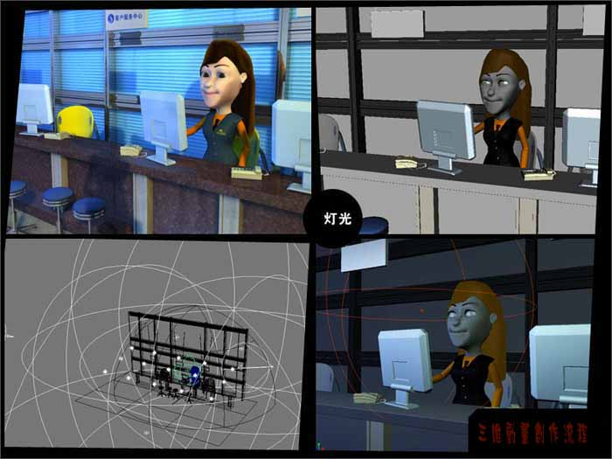
5、Lighting

Slide 27
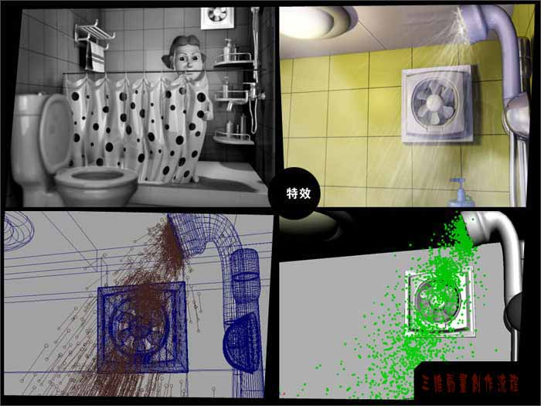
6、Special Effect

Slide 28
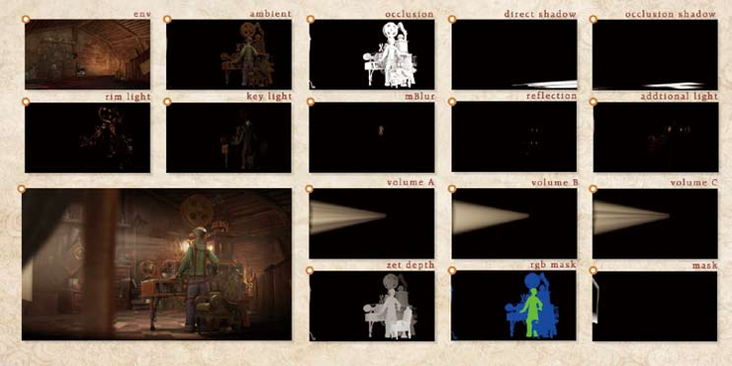
7、Render

Slide 29
Post Compositing:
1、Video Editing
2、Audio Editing
3、Compositing

Slide 30
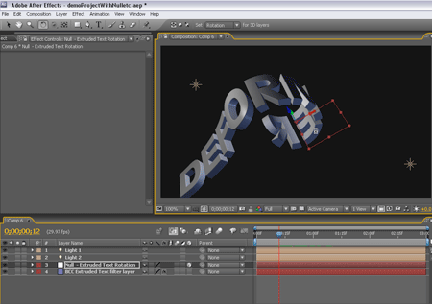

Slide 31
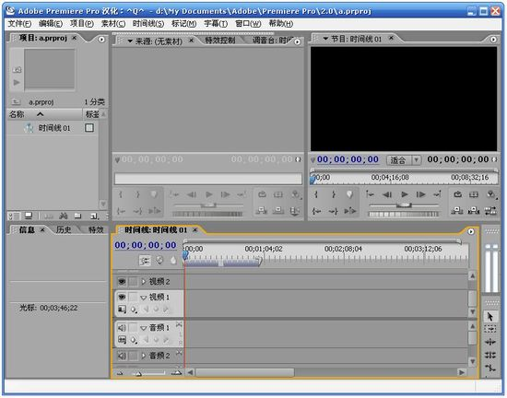

Slide 32
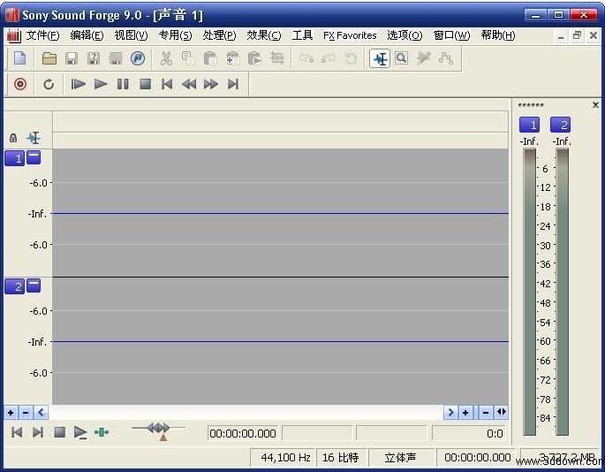
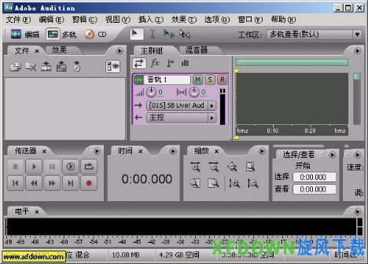

Slide 33

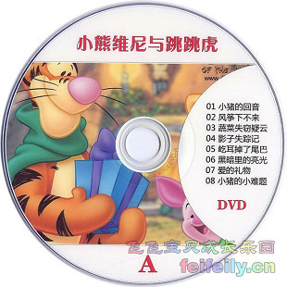

Slide 34
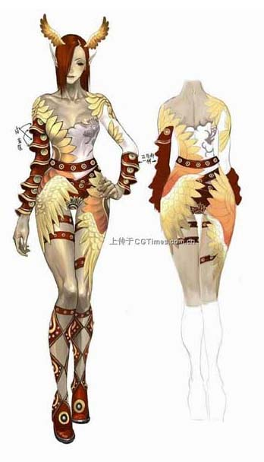
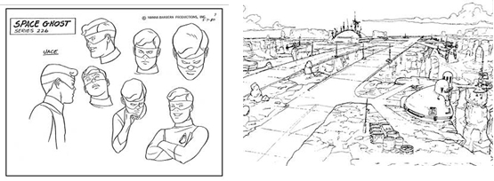
Section 2. Team Composition
1、2D Design：
As a creation department, it provide everything needed during the production according to all the elements from the play, including role, scene, props, etc. For instance, to provide the modeling department the plan of the characters and scenes design draft or sculpture; to provide a storyboard or a shooting to the animation department; to provide the material light department with rendering.

Slide 35
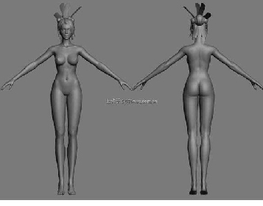
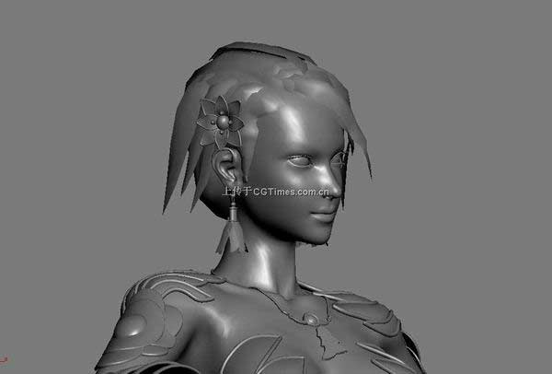
2、Modeling：
To create everything showed in all of the lens, such as role, scene, prop, and create digital animation model according to their designs.

Slide 36
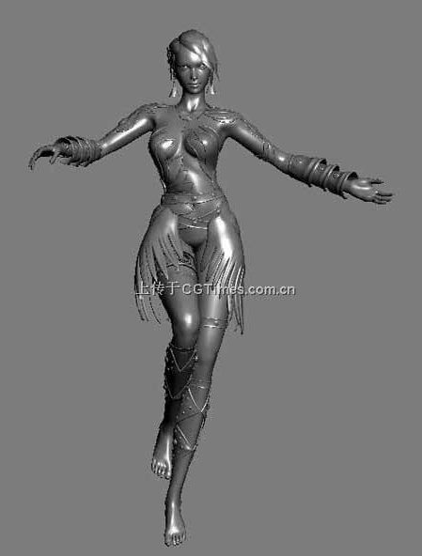
3、Setup：
Since the computer doesn't know the neck will be bent and the structure of the arm muscles, etc, to make it move reasonably in the play, setup department came into being, which prepares motion settings for the animation department.

Slide 37
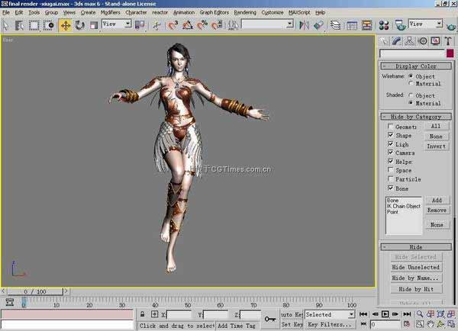
4、Shading：
To make materials for objects and roles in the scene according to the specified color and texture from the preliminary department.

Slide 38
5、Layout:
To divide lens and camera movements depending on the storyboard and the play as well as submit the lens data to the animation department,which makes movie for the roles based on the lens numbers.
6、Animation：
It's a department that makes movie for roles with a len or a role as the basic unit.Simply speaking,animators are actors in the film.You can see,all the vivid performances,each smile and each movement of roles,are made by them,

Slide 39
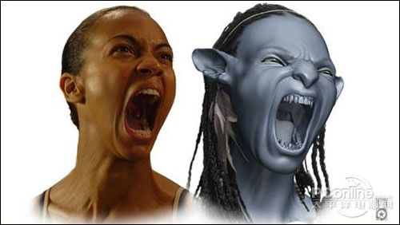
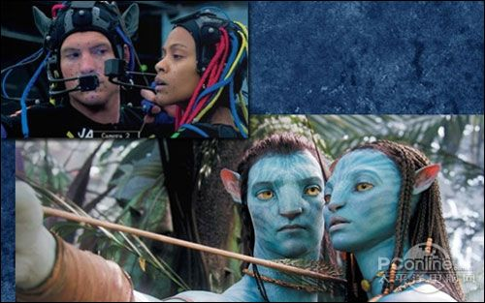

Slide 40
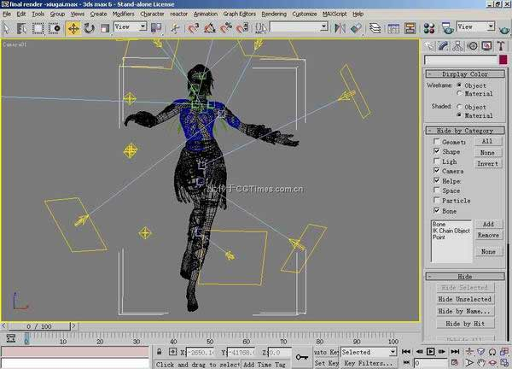
7、Lighting：
To set light for lens according to the design draft and rendering from preliminary departments.

Slide 41
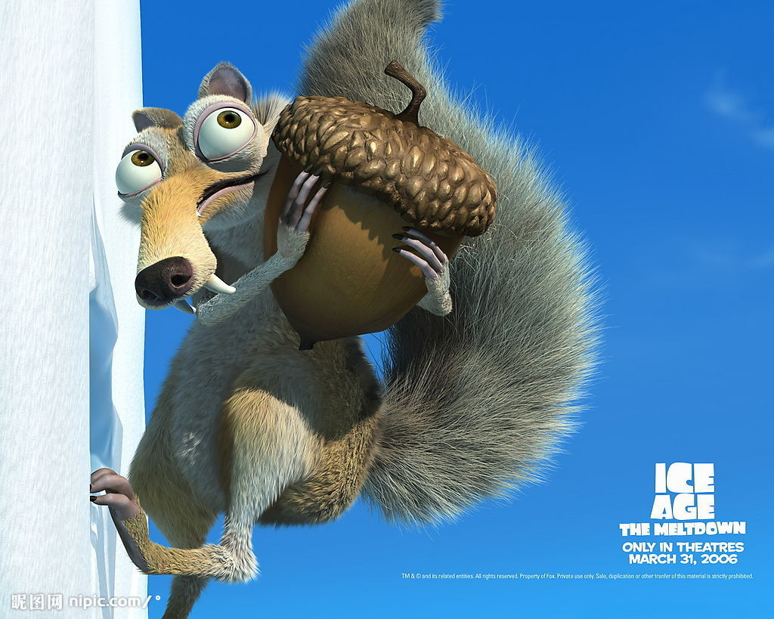
9、 Special effects ：
To make some special effects,for example,to simulate the physical effect, the effect of natural phenomena, cloth, hair, etc.

Slide 42
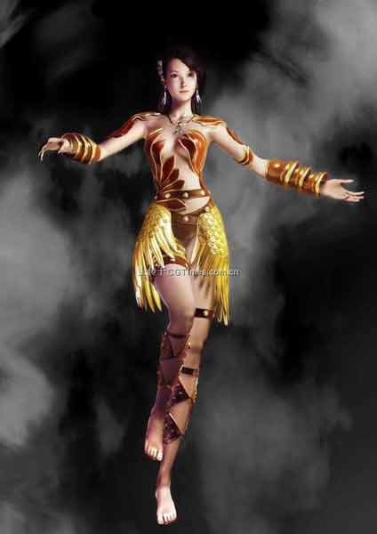
10、Rendering：
It's the last work of the pipeline to translate data into visible images.They batch render all the files to get the sequence frame.

Slide 43
11、Sound Design：
Sound production,including dialogue, music, sound effects and so on.,generally dialogue and music will be complished in the early as animation work depends on the sound.
12、Compose：
To render and adjust the image,then add voice synthesis and come to the final output piece.
13、Tools：
Writing computer softwares, scripts, special effects plug-ins to satisfiy all it needs.

Slide 44
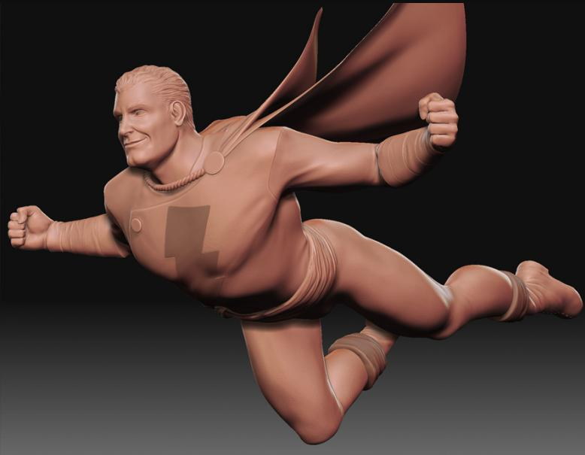
Section 3. The Relationship Between Each Flow
1、Modeling & Animation：
There seems no relationship between them, but animations lie on models in some special scenes. For instance, role model determines the skeleton binding requirements.

Slide 45
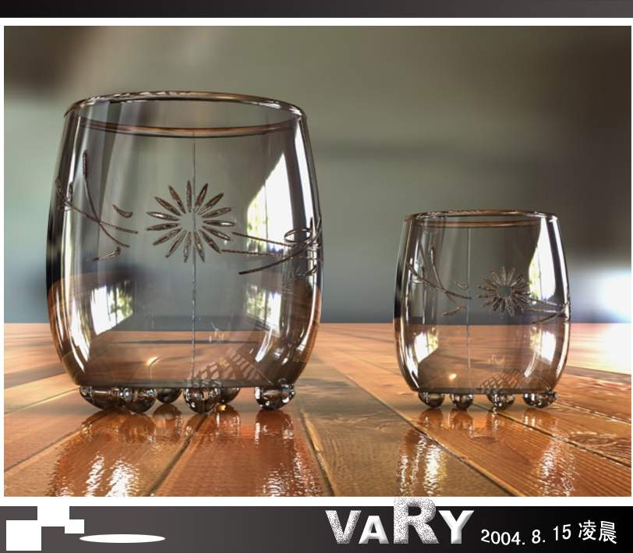
2、Model & Rendering：
Models influence on the drawing and processing of textures directly, whose structure affects the effect of the lighting and rendering.

Slide 46
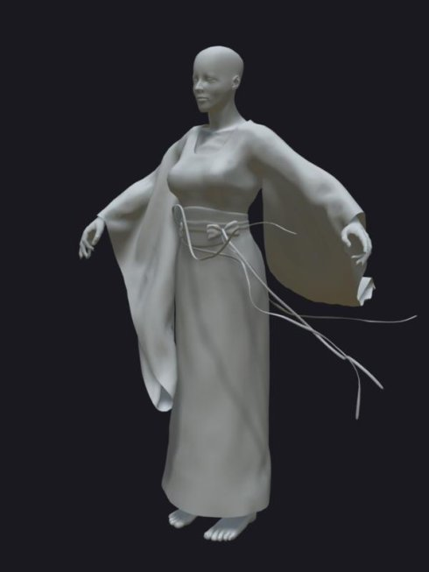
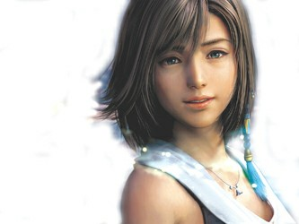
3、Model & Special Effect：
Usually we attach special effects to models, such as fur, cloth, ocean and so on, which are immediately based on the complexity of models.

